Slide 1
Structure Factors and Identify Particle Heterogeneity
Gun Woo Park
03 NOV 2015

Slide 2
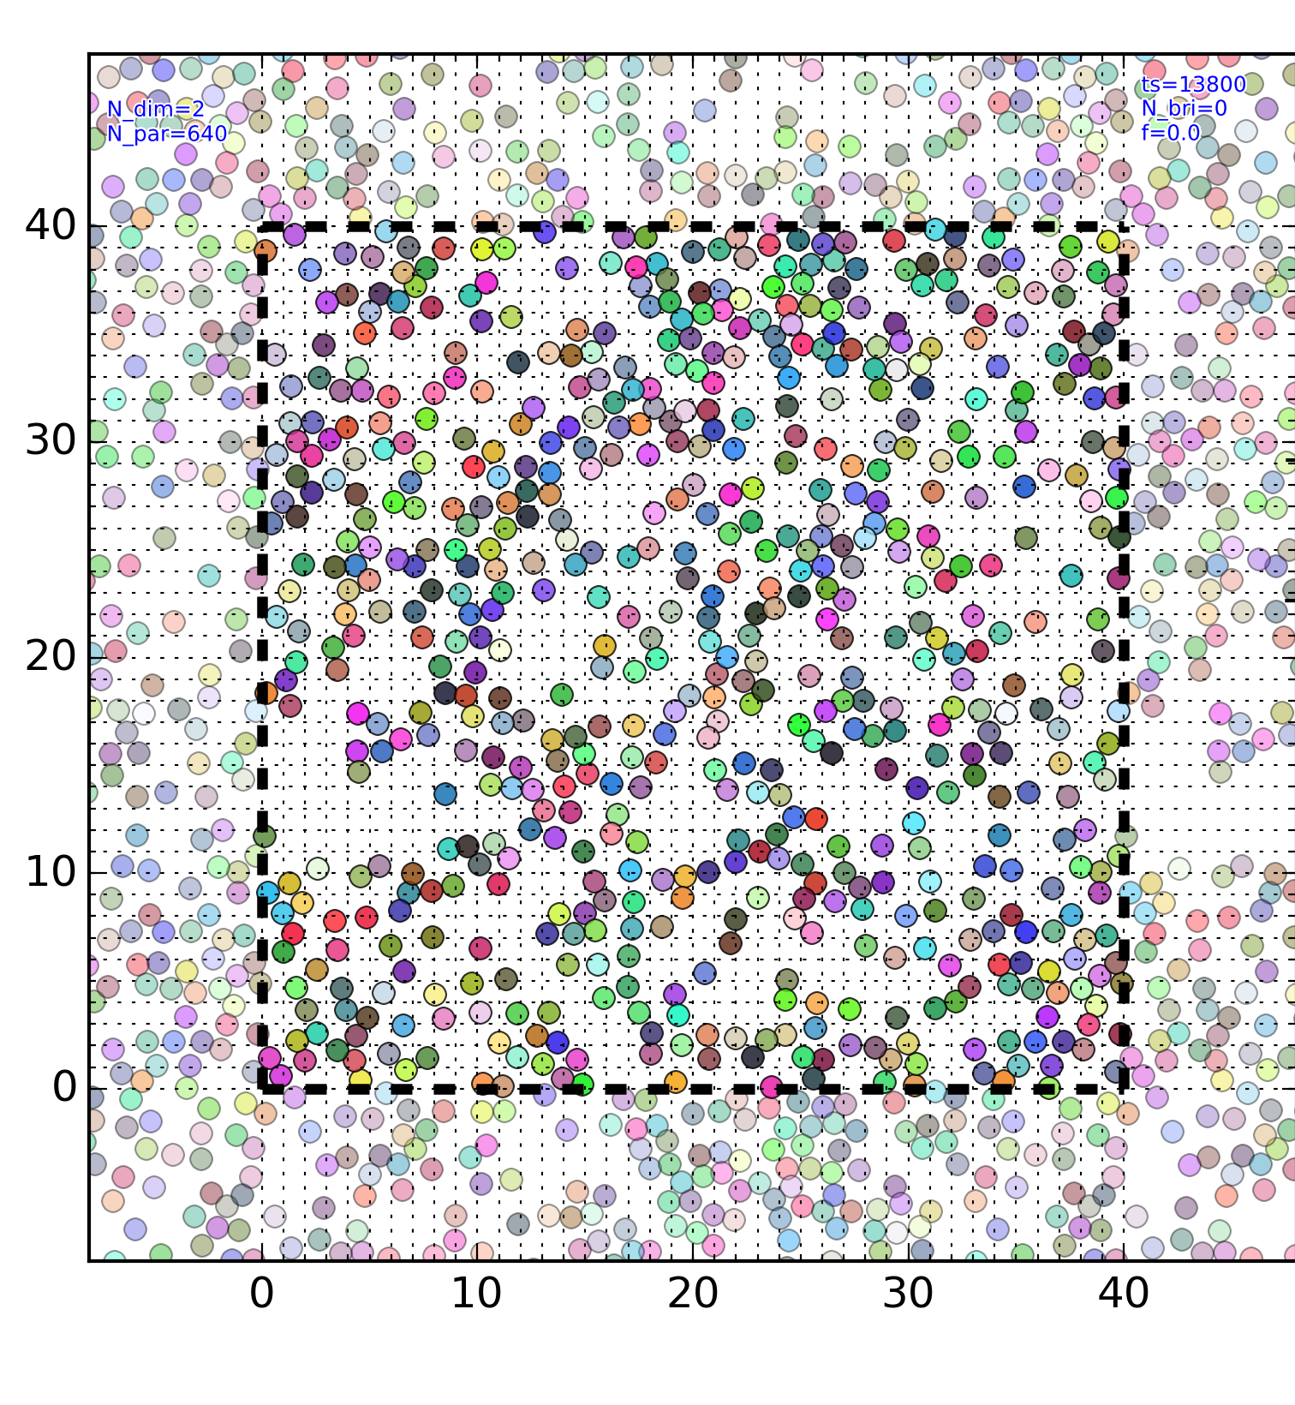
640 PURE REPULSION

Slide 3
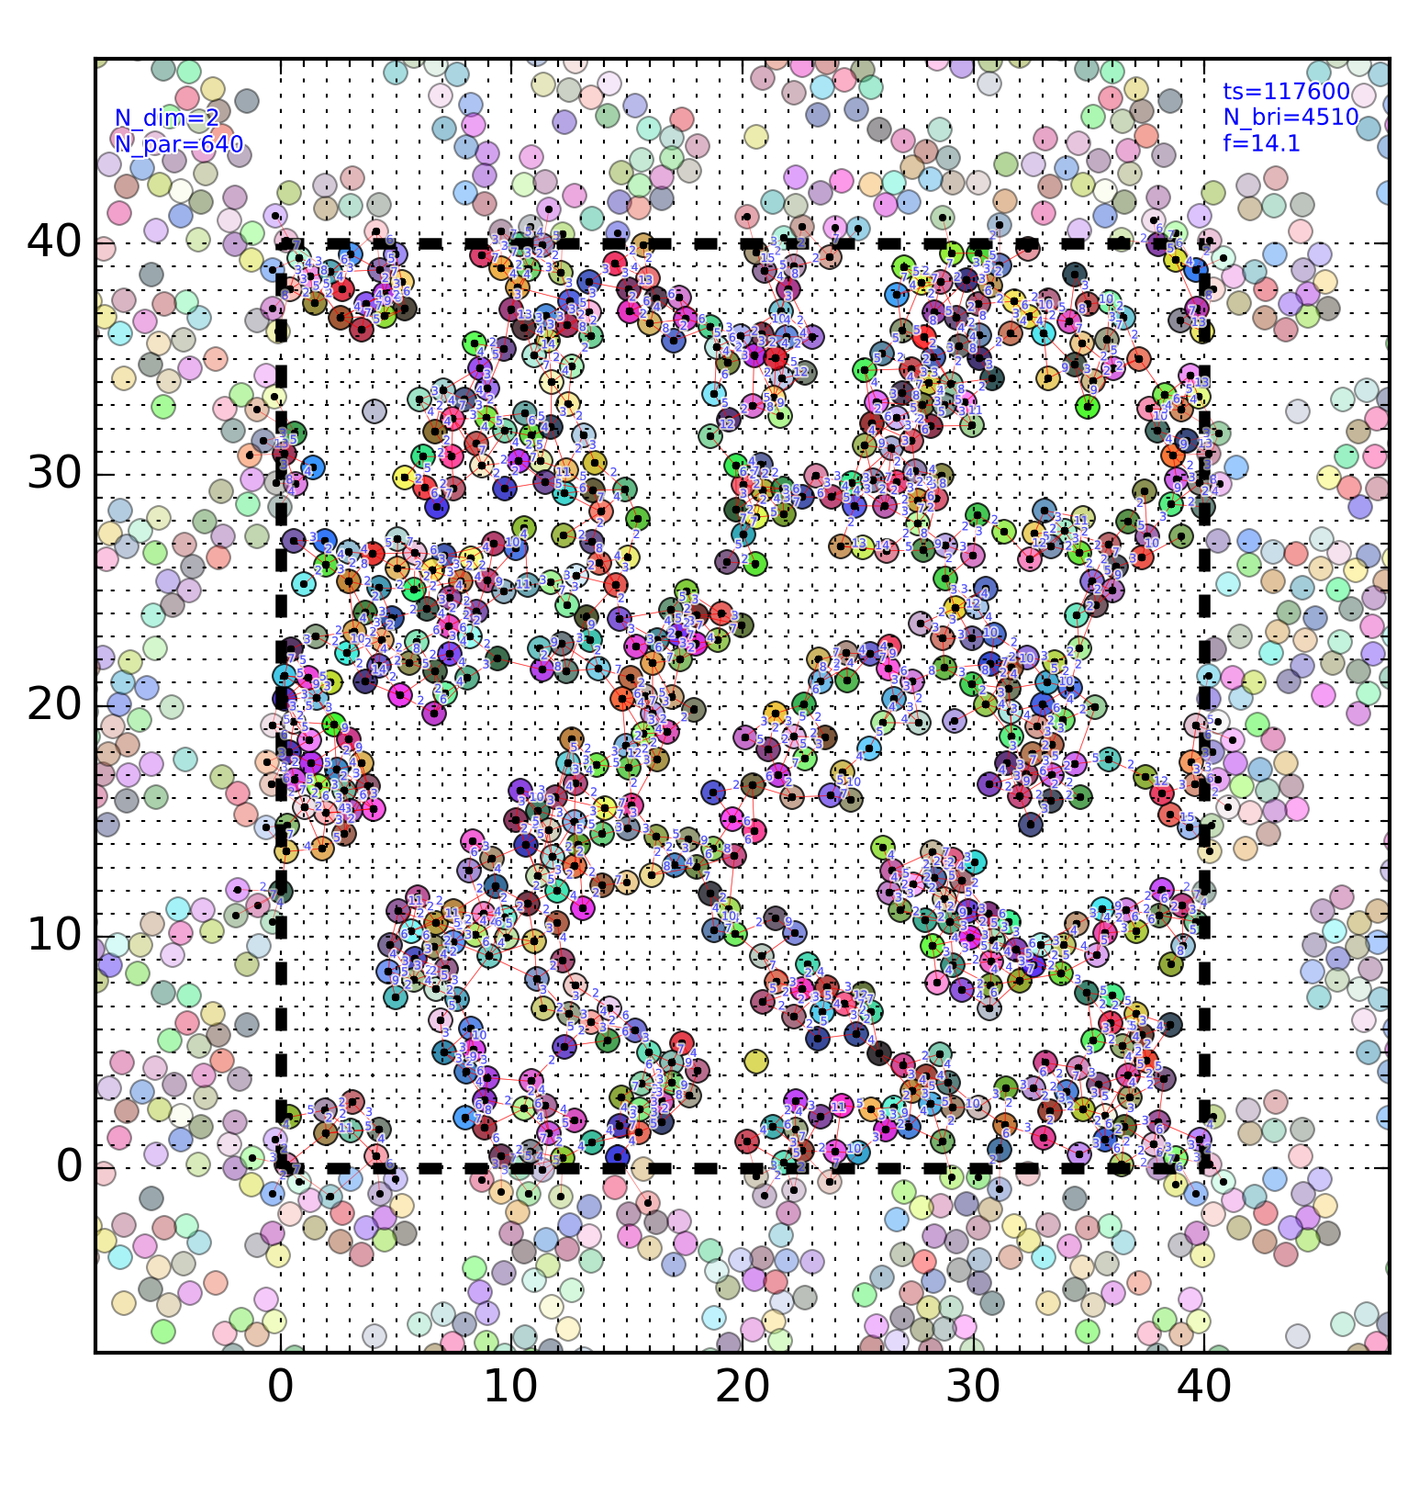
640 GAUSSIAN

Slide 4
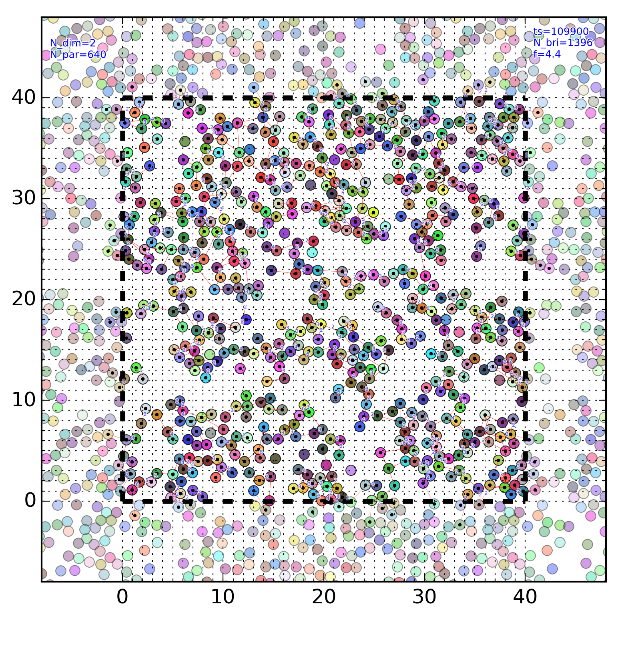
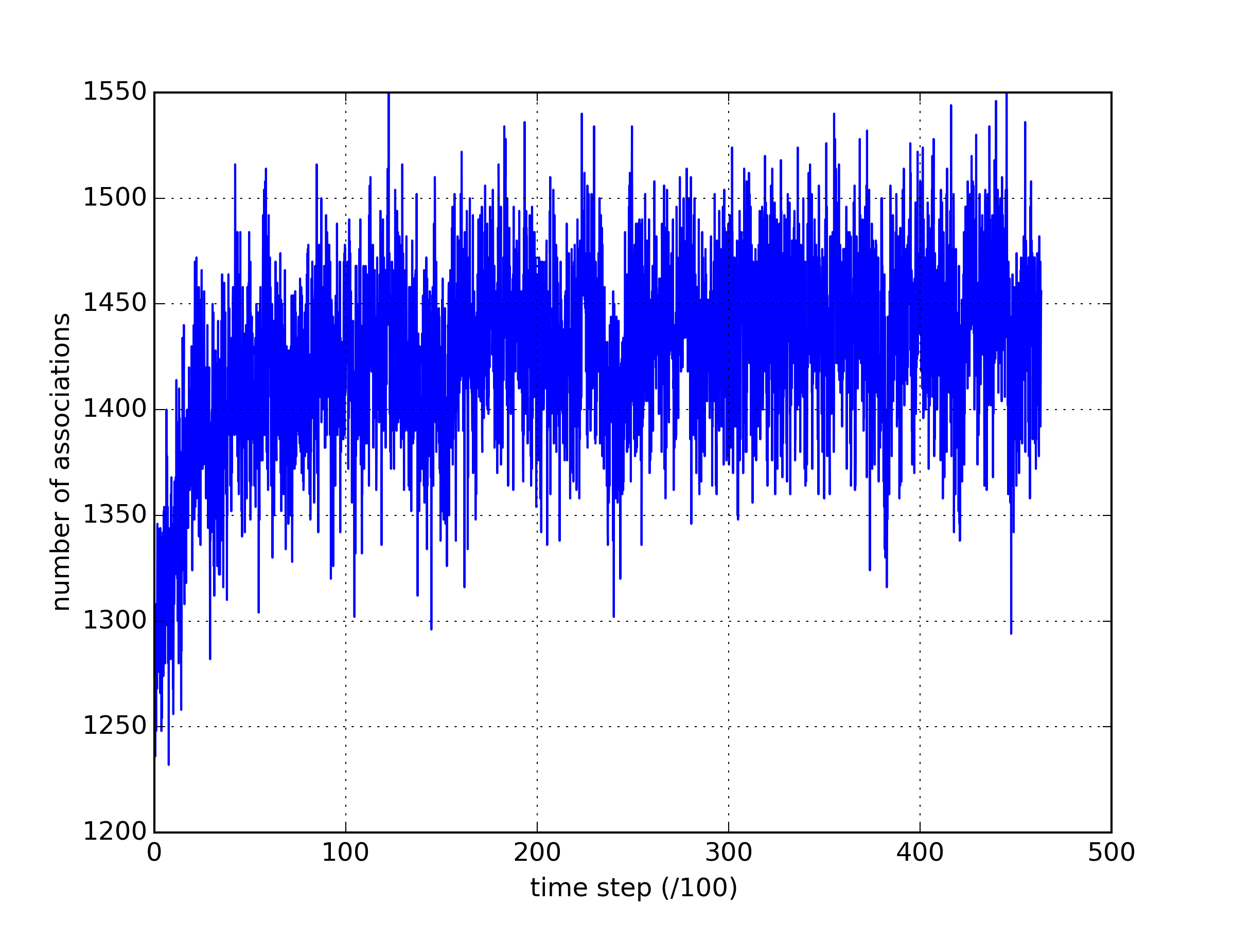
640 FENE R11

Slide 5
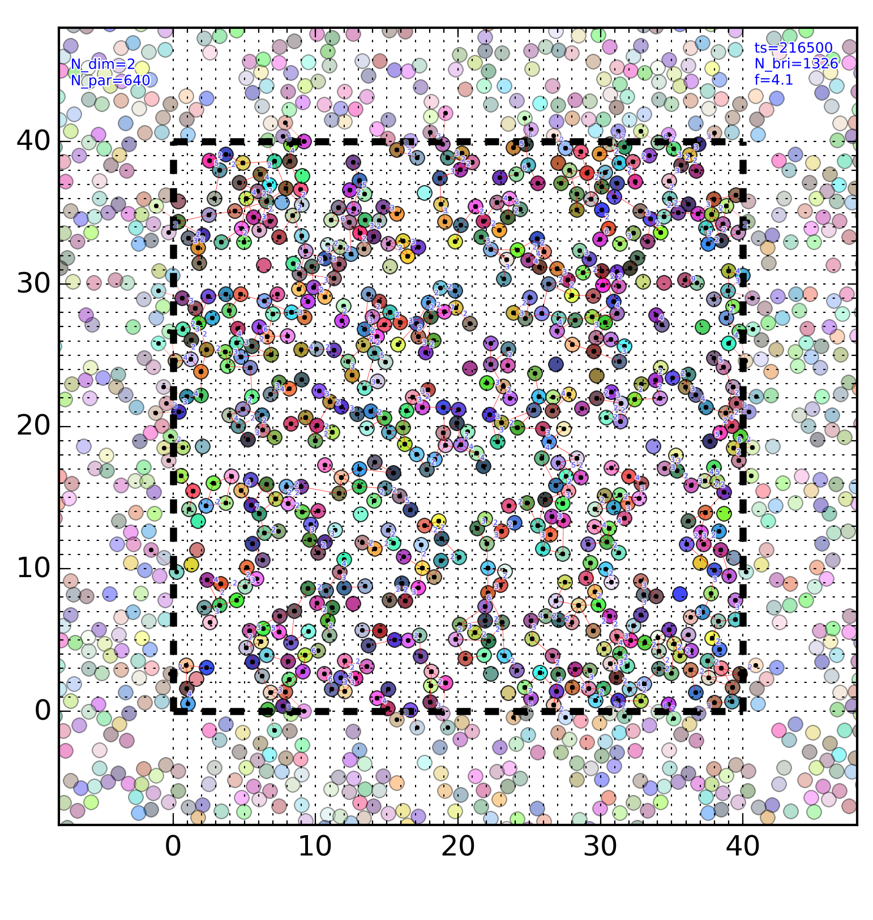
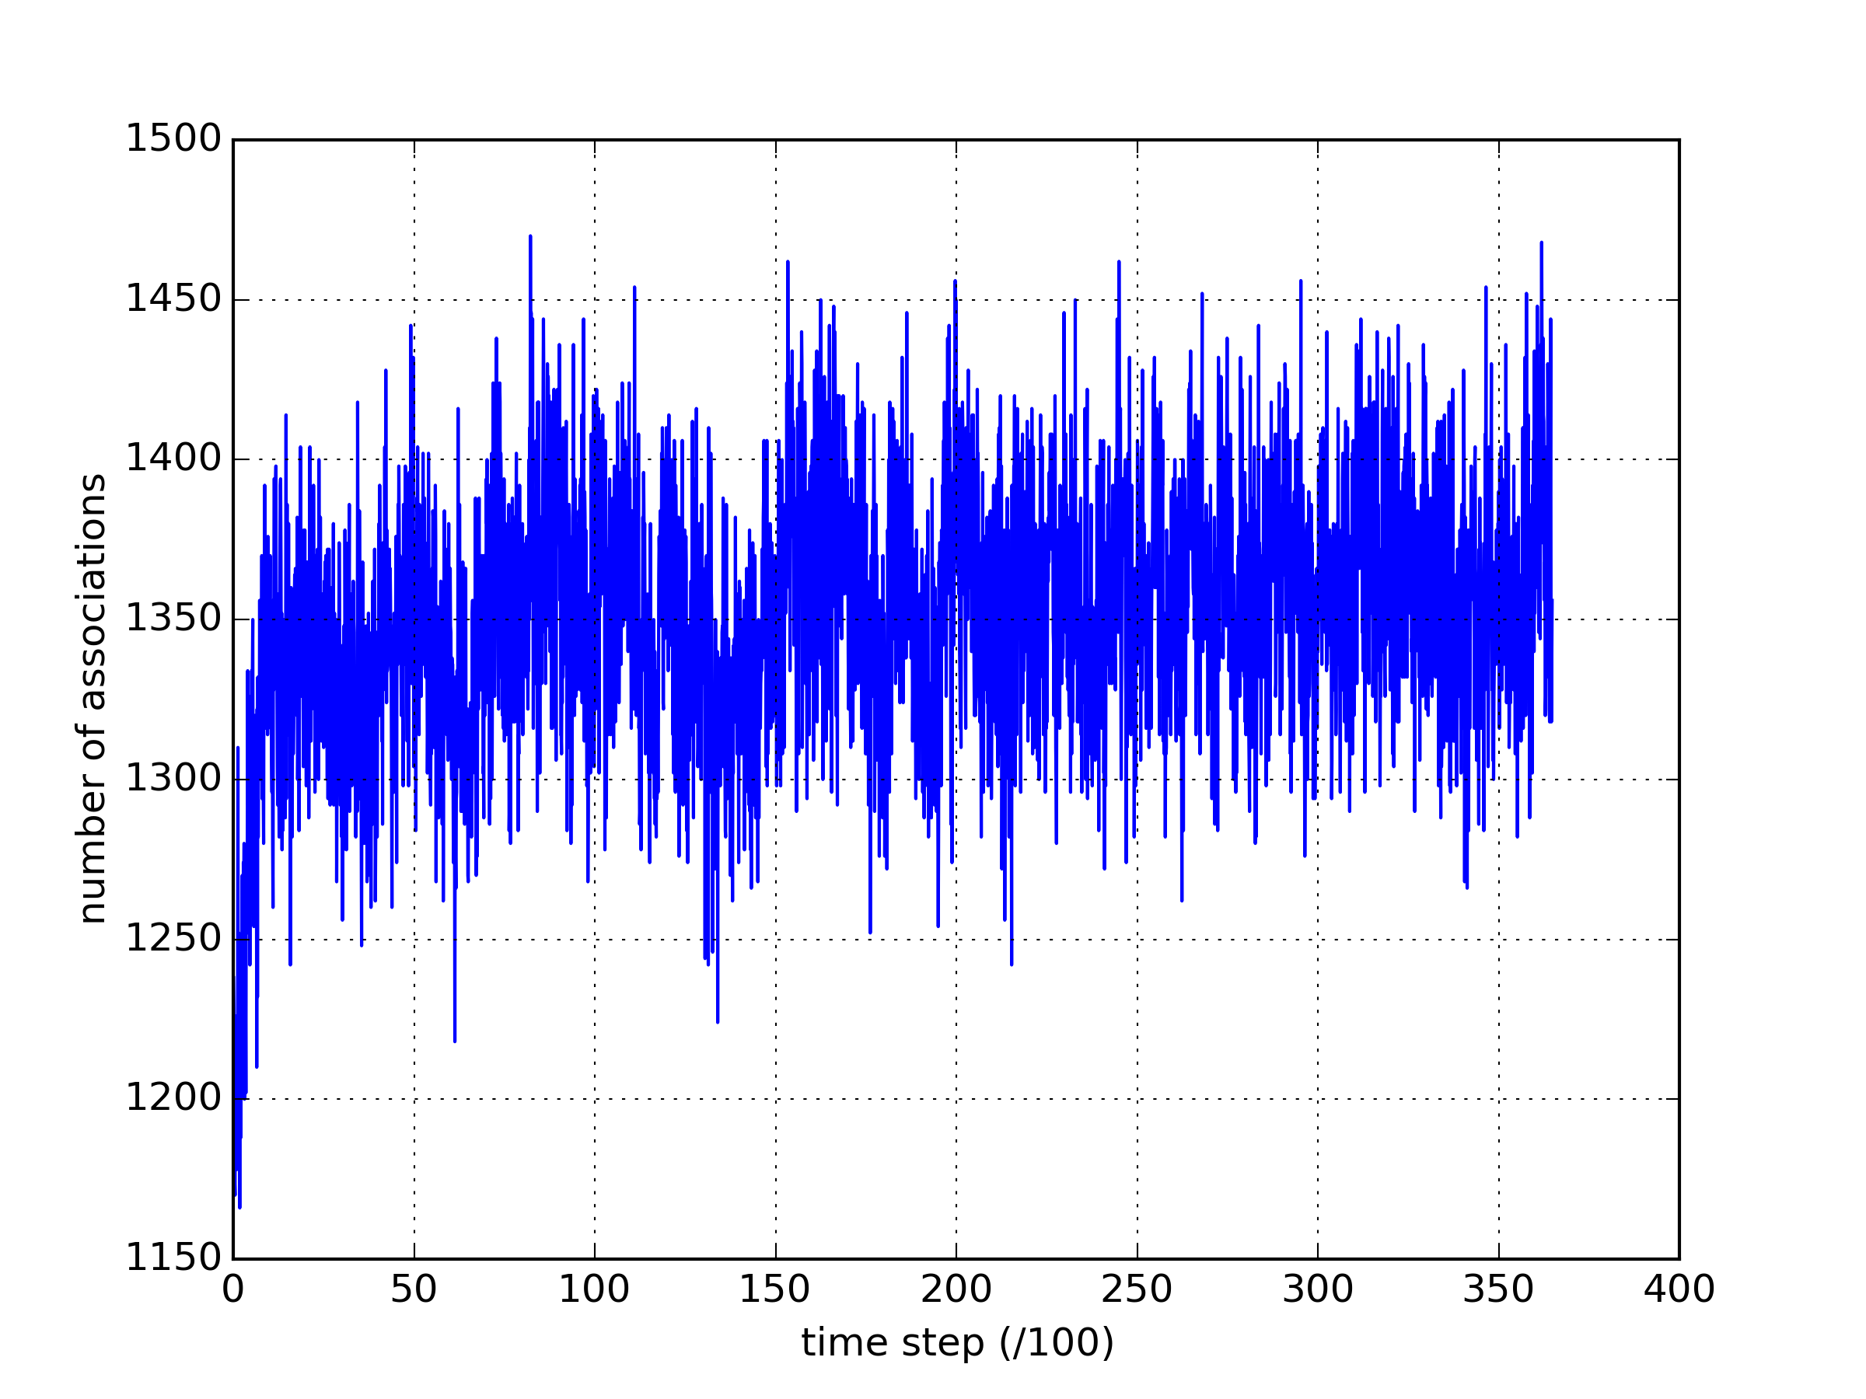
640 FENE R06

Slide 6
g(r), S(q) comparison

Slide 7
Works in progress
Identification of Equilibrium status (through structure factor, number of associations)
Refinement and boosting the code (infrastructure)
Parallel Monte Carlo step for associations

